Slide 1

Painless Scaling:
Rewiring for Scalability with Apache Cassandra™
Ben Werther
VP of Products, DataStax
ben@datastax.com

Slide 2
What I’m Going to Cover
Who are we?
What industry shifts are we seeing?
What is Cassandra, and why does it exist?
Who is using it, and how is it being used?
What is DataStax’s role in this?
Where is this all going?
Questions

Slide 3



About DataStax
DataStax is the commercial leader in Apache Cassandra™
  We changed our name from Riptano recently
We build products and services to make it easy for customers to build and operate high-volume real-time applications
  Powered by Apache Cassandra™
Founded in early 2010 by Matt Pfeil and Jonathan Ellis
  Jonathan is the leader and project chair of Apache Cassandra
More than 50 customers including:
  Netflix, Cisco, Openwave, Ooyala, Constant Contact, RealNetworks, Rackspace
Based in Burlingame, CA
  With offices in Austin, TX and Stamford, CT
More than 25 employees
  Large pool of the core Cassandra project developers, plus superb pool of enterprise distributed systems talent
Investors Include:

Slide 4
The Next Wave: Big Data + Real Time
If you are a leading Enterprise or Web company, then:
  You are in the data business
  You are continually fighting to scale your systems
We all talk about ‘big data’
  But not yet in the context of real-time applications
  Usually referring to data warehouses or Hadoop
But we don’t live in an off-line processing world
  We’re in a real-time world – instant answers, immediate insight, algorithmic decisions, etc.
  Need to be able to scale data volumes, number of requests, etc while maintaining real-time/low-latency

Slide 5
Enter Google and Amazon
The first to feel the pain were the web leaders
  Millions of users creating massive data streams for low-latency web applications
  Need for incredibly low TCO and commodity scaling
Rapid innovation beyond RDBMS technology
  Google BigTable, Colossus, etc
  Amazon Dynamo
Systems designed for the new scaling realities
  No single point of failure
  Revisit some assumptions around transactions, consistency vs availability
  Immensely successful at their stated goals
Neither is available outside their organizations

Slide 6
Emergence of Apache Cassandra™
Was incubated at Facebook by Avinash Lakshman
  Incorporated the best of Google’s BigTable and Amazon’s Dynamo models in one system
Was open-sourced by Facebook in 2008
  Became an Apache top-level project under the leadership of Jonathan Ellis (DataStax)
Considered the ‘best-of-breed’ big-data real time infrastructure
  In use at 1000s of organizations worldwide, including Twitter, Netflix, Cisco, Rackspace, as well as in government/intelligence, financial services, telecommunications and logistics
Solves real time and analytical big data problem
  From write intensive workloads to sub millisecond caching layer reads to analytical workloads involving petabytes of data using MapReduce

Slide 7
Cassandra – Technical Differentiators
Massively scalable ring architecture
Flexible schema-less data modeling
Extreme write performance with durability
Tunable/Eventual Consistency
Multi-datacenter replication
Hadoop integration
No caching layer required

Slide 8
Some Typical Cassandra Use Cases
High-volume web application data storage/access
Replacing complex multi-layer caching architectures with a single layer of low-latency scalability
Tracking high-volume financial transaction data
Real-time analytics for high-volume video serving
Storing actions of millions of users in massively multiplayer games
Scalable text indexing and search
Complex entity modeling/analysis for intelligence applications
Storing and searching billions of emails
Storing and correlating complex event streams
Offloading low-latency session and state management from Oracle-backed applications

Slide 9
DataStax is the Commercial Leader in
Apache Cassandra
The company has three areas of focus:
  Core open-source Cassandra
    Jonathan Ellis leads the Apache project, and DataStax plays a leading role in industry-wide work on the project
  Products and services to help customers be successful with Cassandra
    DataStax OpsCenter for Apache Cassandra
    Expert support, consultation and training
  Enterprise technology powered by Cassandra
    Using Cassandra to inject scale into existing Java applications and enterprise services

Slide 10
Customer Video
http://www.youtube.com/watch?v=vxa06fX1a2I

Slide 11
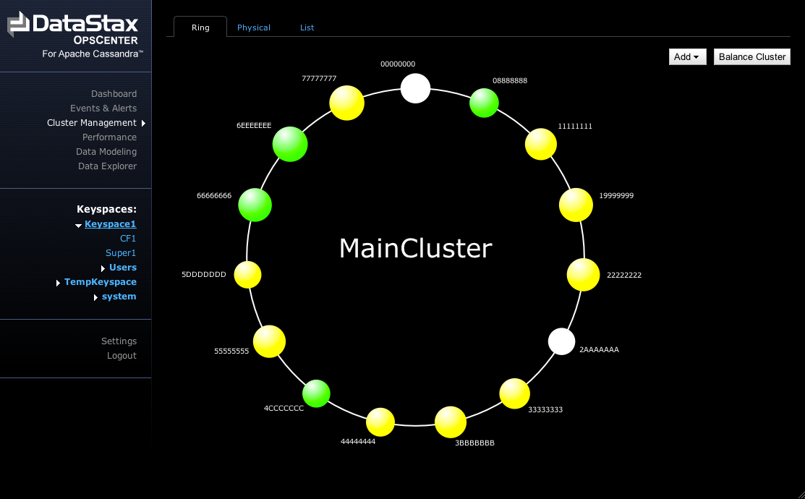
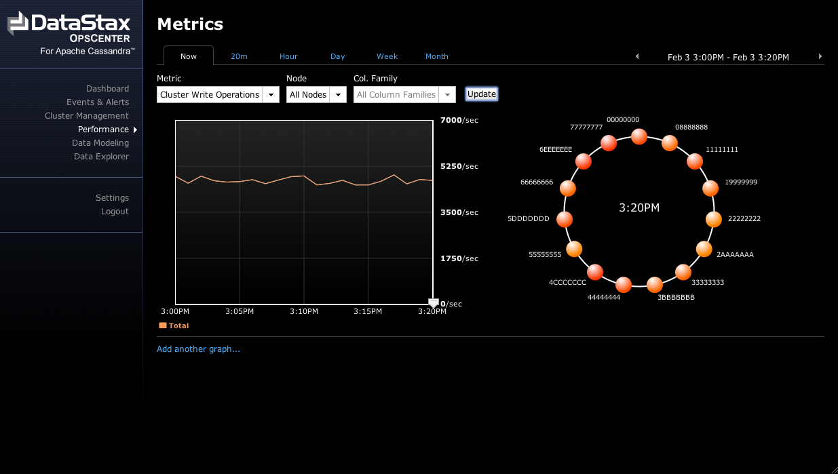
Announcing DataStax OpsCenter for Apache Cassandra
DataStax OpsCenter is the first platform for managing, monitoring and operating Web and enterprise Cassandra applications.
  Sophisticated visualizations of a Cassandra cluster
  Comprehensive management and configuration
  Health and performance monitoring.
OpsCenter is bundled with DataStax's tiered Cassandra support services, and will also be available as a free edition for non-production usage.

Slide 12
What’s Next
Continued core Cassandra innovation
  Enhanced Hadoop/Hive/Pig integration
  Foundation for more sophisticated real-time analytics
  Lots more
DataStax Scalability Platform
  Bringing the benefits of Cassandra to a wider audience by ‘injecting’ apps or services into a Cassandra-powered scalability substrate.
  Stay tuned for more here.
Injection-ready App or Service
Injection-ready App or Service
Injection-ready App or Service
Platform common services
‘Injected’ Apps/Services Runtime
Apache Cassandra – Data & Scalability core
DataStax Scalabiity Platform node

